Slide 1
Linked list-Operations

Slide 2
Basic Operations on Linked List
Traversal: To traverse all the nodes one after another.
Insertion: To add a node at the given position.
  Insertion at the beginning
  Insertion at the end. (Append)
  Insertion after a given node
Deletion: To delete a node.
  Find the previous node of the node to be deleted.
  Change the next pointer of the previous node
  Free the memory of the deleted node.

Slide 3
Deletion: To delete a node.
Searching: To search an element(s) by value.
Updating: To update a node.
Sorting: To arrange nodes in a linked list in a specific order.
Merging: To merge two linked lists into one.

Slide 4
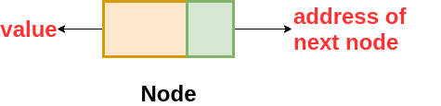
structure of the node in the Singly Linked List is
class Node{
  int data // variable to store the data of the node
  Node next // variable to store the address of the next node
}

Slide 5
DLL
class DLLNode {
  int val // variable to store the data of the node
  DLLNode prev // variable to store the address of the previous node
  DLLNode next // variable to store the address of the next node
  }

Slide 6
Traversal
Start with the head of the list,access the content of the head node if it is not null.
Then go to the next node(if exists) and access the node information
Continue until no more nodes (that is, you have reached the null node)
void traverseLL(Node head){
while(head != NULL)
{
print(head.data) head = head.next
}
}

Slide 7
Insertion at the beginning
Node insertAtBegin(Node head, int val)
{
newNode = new Node(val) // creating new node of linked list
if(head == NULL) // check if linked list is empty
return newNode
else // inserting the node at the beginning
{
newNode.next = head
return newNode
}
}

Slide 8
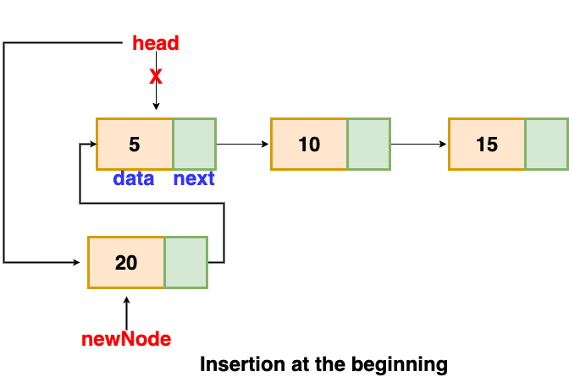

Slide 9
Insertion at end
We will traverse the list until we find the last node.
Then we insert the new node to the end of the list.
Note that we have to consider special cases such as list being empty.
In case of a list being empty, we will return the updated head of the linked list because in this case, the inserted node is the first as well as the last node of the linked list.

Slide 10
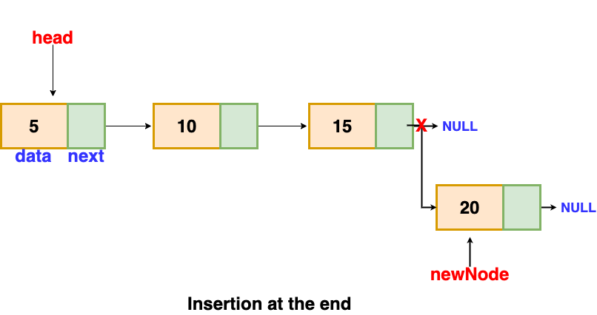

Slide 11
Node insertAtEnd(Node head, int val)
{
if( head == NULL ) // handing the special case
{
newNode = new Node(val)
head = newNode
return head
}
Node temp = head
// traversing the list to get the last node

Slide 12
while( temp.next != NULL )
{
temp = temp.next
}
newNode = new Node(val)
temp.next = newNode
return head
}

Slide 13
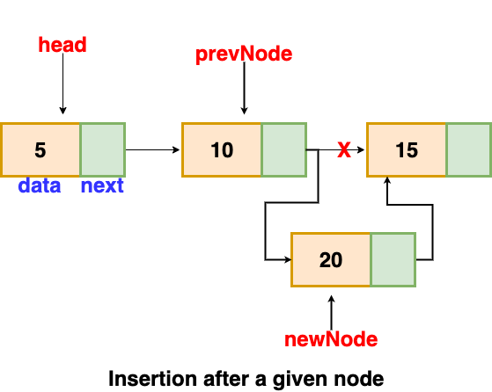
Insertion after a given node
We are given the reference to a node, and the new node is inserted after the given node

Slide 14
void insertAfter(Node prevNode, int val)
{
newNode = new Node(val)
newNode.next = prevNode.next
prevNode.next = newNode
}

Slide 15
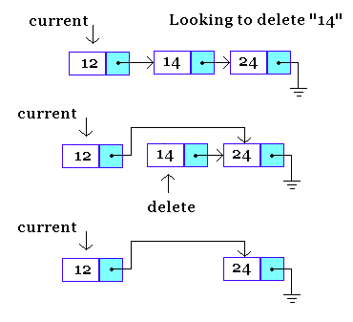
Deletion
If the node to be deleted happens to be the first node.
If the node happens to be in the middle of the list.
If the node is at the end of the list.

Slide 16
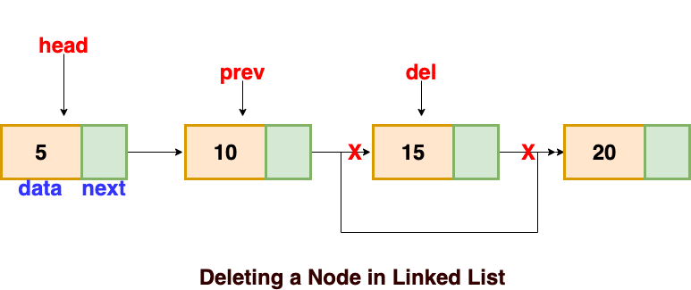
Linked List node Deletion
Find the previous node of the node to be deleted.
Change the next pointer of the previous node
Free the memory of the deleted node.
there is a special case in which the first node is deleted. In this, we need to update the head of the linked list.

Slide 17
Node deleteLL(Node head, Node del)
{
if(head == del) // if the node to be deleted is the head node
{
return head.next // special case for the first Node
}
Node temp = head
while( temp.next != NULL )

Slide 18
{
if(temp.next == del) // finding the node to be deleted
{
temp.next = temp.next.next
delete del // free the memory of that Node
return head
}
temp = temp.next
}
return head // if no node matches in the Linked List
}

Slide 19
Linked List node Searching
we can traverse the linked list and compares the value present in the node.
bool searchLL(Node head, int val)
{
Node temp = head // creating a temp variable pointing to the head of the linked list
while( temp != NULL) // traversing the list
{
if( temp.data == val )
return true
temp = temp.next
}
return false
}

Slide 20
Linked List node Updation
void updateLL(Node head, int val, int newVal)
{
Node temp = head
while(temp != NULL)
{
if( temp.data == val)
{
temp.data = newVal
return
}
temp = temp.next
}
}

Slide 21
Problems
Reverse linked list
Middle of the Linked List
Odd even linked List
Remove Duplicates from Sorted List
Merge Sort on Linked List
Check if a singly linked list is a palindrome
Detect and Remove Loop in a Linked List
Sort a linked list using insertion sort
Remove Nth Node from List End
https://afteracademy.com/blog/types-of-linked-list-and-operation-on-linked-list

Slide 22
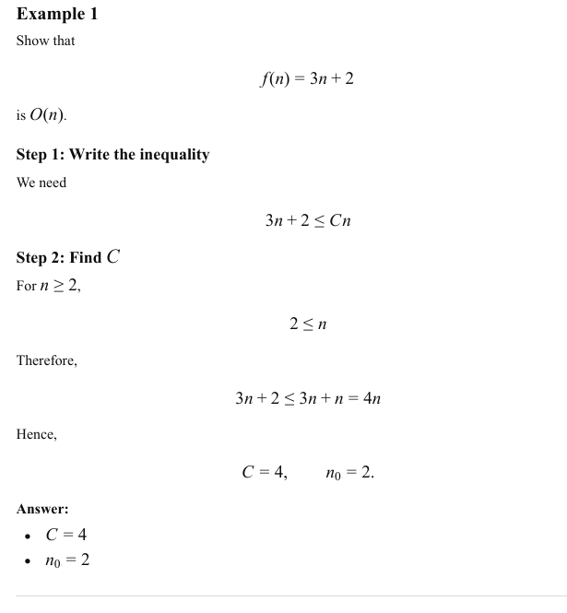

Slide 23
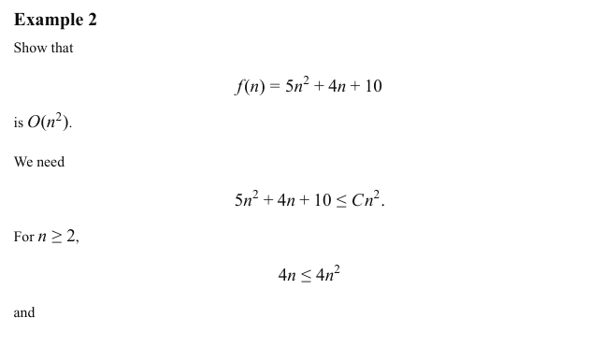

Slide 24
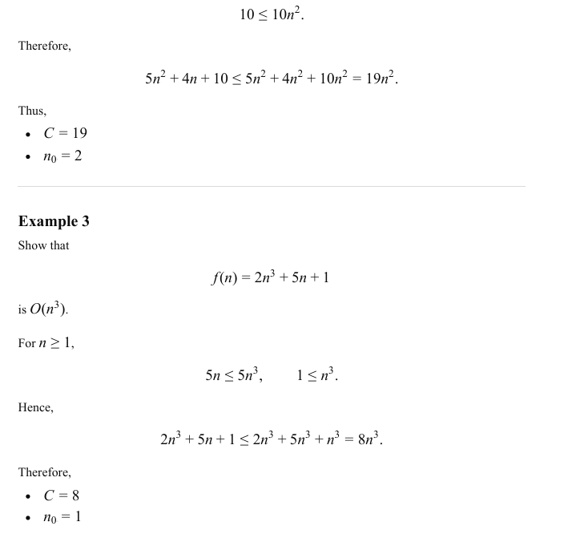

Slide 25
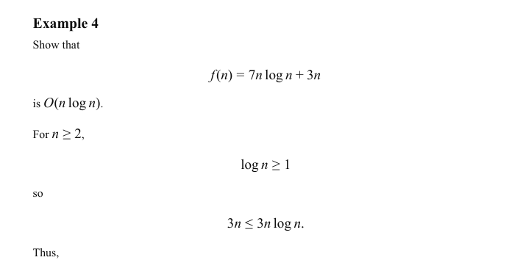

Slide 26


